Slide 1
Seizure Classification with Deep Learning
Group 3
Twyla Keating, 1770979
Zijian Li, 1781642
Enoch Shin, 1767565
Wenqi Zhang, 1785174

Slide 2
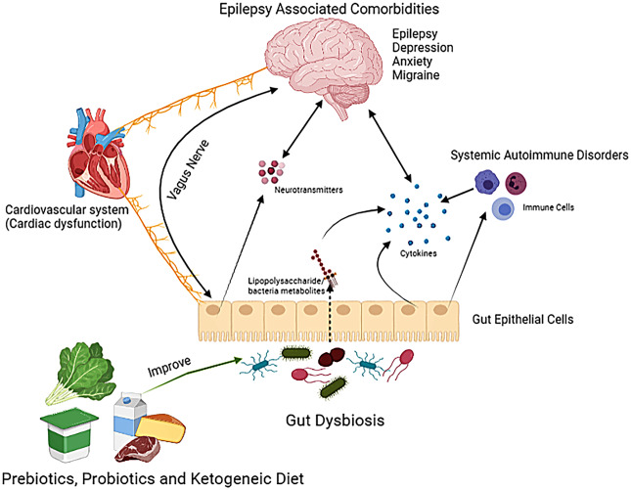
Background and Motivations
World Health Organization -- 50 million people worldwide
“It is estimated that up to 70% of people living with epilepsy could live seizure-free if properly diagnosed and treated.”
Physical and psychological comorbidities
Notes:
https://www.sciencedirect.com/science/article/pii/S0969996122000390

Slide 3
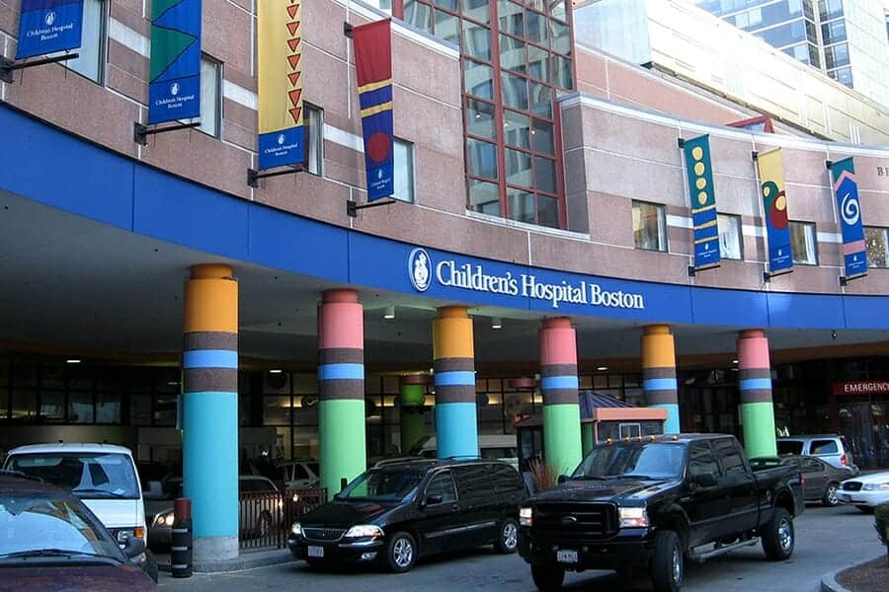
Dataset
Children’s Hospital Boston – MIT EEG recordings from 23 pediatric and one adult patient
23 channels, recorded by EEG cap with 21 electrodes
Segmented into 1-second temporal windows
Notes:
https://dravetfoundation.org/comprehensive-center/boston-childrens-hospital/

Slide 4
Goals
Overall Goal: accurate classification of EEG data, generalizable model
Goal 1 – Model with different data scopes
Window: each unit of time. Represents upper bound of performance (because train and test windows can be from same seizure episode)
Fix window leakage and same-person patient
Seizure: split by seizure vs. non-seizure events
Patient: most generalizable, for modeling unseen patients
Goal 2 -- Compare two architectures
Classification with channel fusion (no temporal data / “memory”)
LSTM methods to incorporate temporal data
difficulty

Slide 5
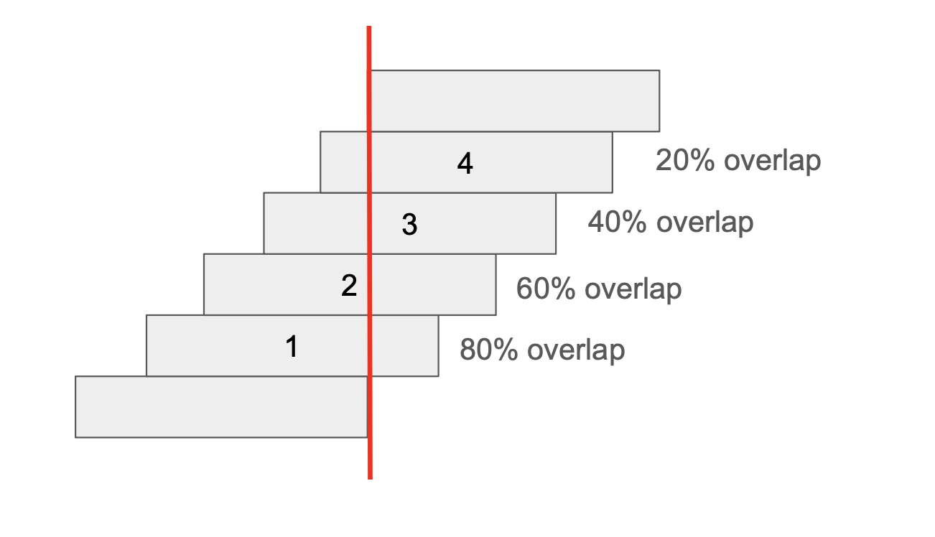
Additional data splitting / cleaning
Combine chb01 and chb21 (same person)
Window leakage: artificially high performance
Ensure no overlapping data across train and test

Slide 6
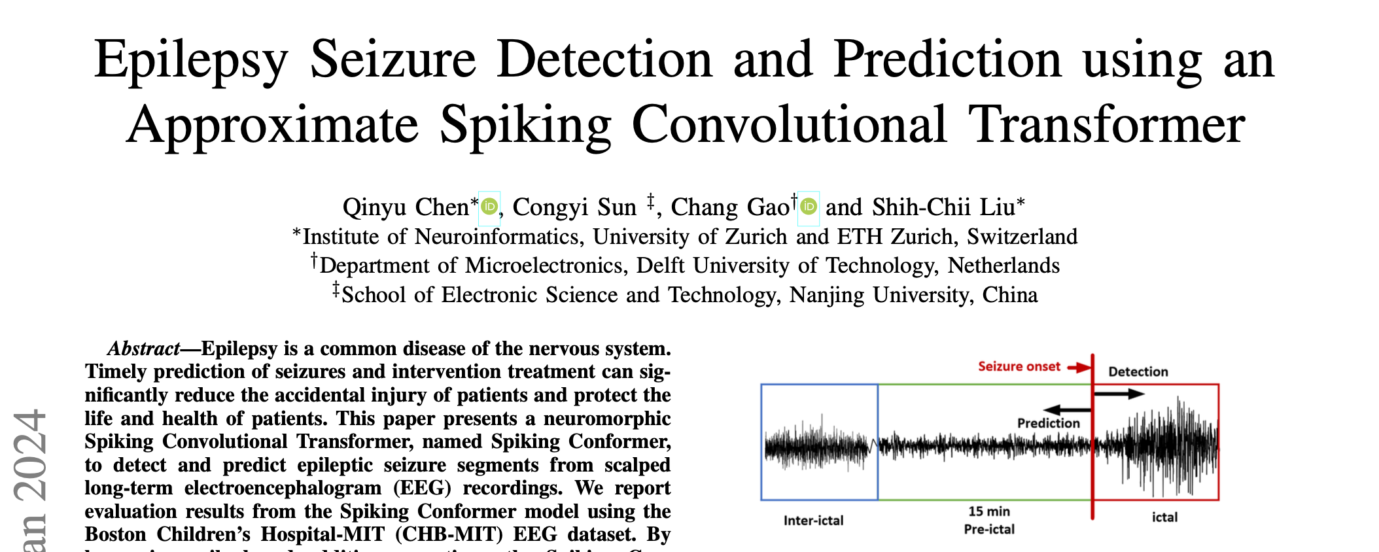
Methodology: Architecture Selection
Classification (not temporal) → CNN
Why: well-validated in existing literature, light computation
Serves as baseline because it doesn’t use sequential context
With temporal data → Spiking Convolutional Transformer
Why: recent literature from 2024, reflects more cutting-edge method
We will discuss this later in the final submission.

Slide 7
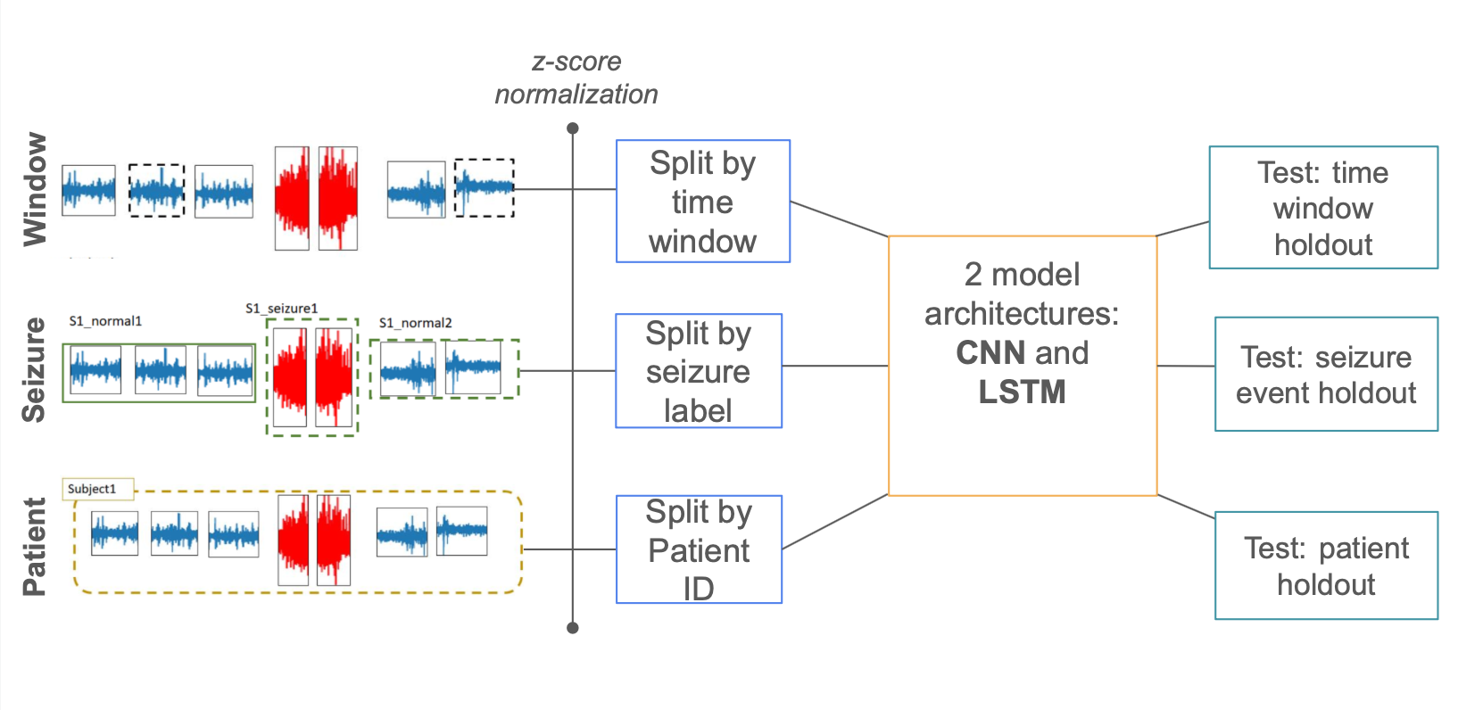
CNN Methodology Overview
CNN is a simple baseline to help us see difference in data splits (patient, seizure, window)

Slide 8
LSTM Methodology Overview
Selectively preserve or discard information across time steps via learned input, forget, and output gates
Two types of LSTM
Sequential: train CNN, freeze weights, use it as a feature extractor
Problem: CNN extracts from single 1-second window, might miss temporal patterns
End-to-end: train CNN and LSTM at same time
Benefit: back propagation can give feedback to CNN
We picked this one.

Slide 9
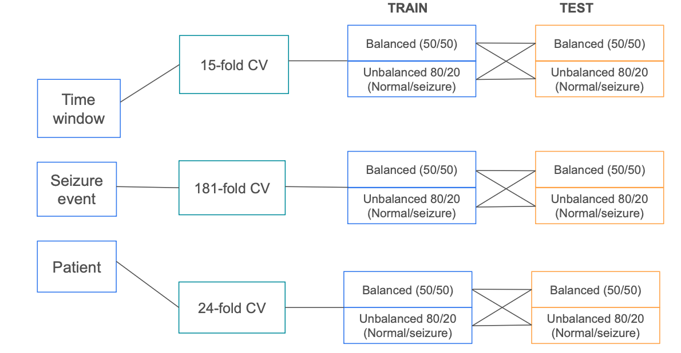
Experimental Design
Dataset is very unbalanced (~85% normal vs. 15% seizure)
3 × 2 × 2 design for different stress testing
3 data splits (Window vs. Seizure vs. Patient)
2 training modes (50-50 Balanced vs. 80-20 Unbalanced)
2 testing modes (50-50 Balanced vs. 80-20 Unbalanced)

Slide 10
CNN Steps
Step 1: Pre-process
Z-score normalization: dynamically per fold rather than globally (avoids leakage)
Class balancing for both train and test
Step 2: Training
Conv1d: “early channel fusion” – looks 1-dimensionally at all 21 EEG electrodes simultaneously
2 training modes (50-50 Balanced vs. 80-20 Unbalanced)
Split data over 10 shards due to size
Step 3: Classification (window, seizure, patient)
Test with both balanced and unbalanced sets

Slide 11
LSTM Steps
Step 1: Pre-process (Sequence Generation)
Temporal sequencing: data grouped into chronological sequences of 8 consecutive sliding windows
Step 2: Training
CNN Feature Extraction: uses same Conv1d method to compress 21 electrodes into spatial feature vector.
Temporal Aggregation (LSTM): reads sequence of 8 feature vectors to model brainwave evolution over time.
Joint Optimization: CNN and LSTM are trained simultaneously (end-to-end) across 2 training modes (Balanced vs. 20-80)
Step 3: Classification (window, seizure, patient)
Test with both balanced and unbalanced sets

Slide 12
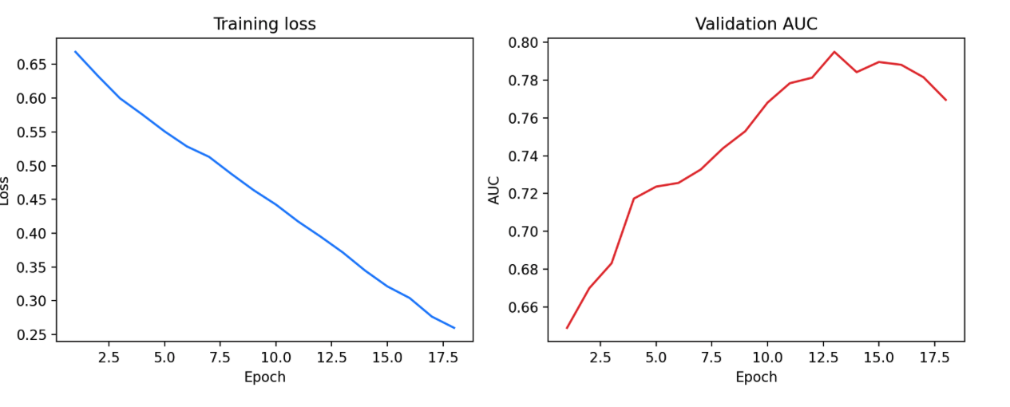
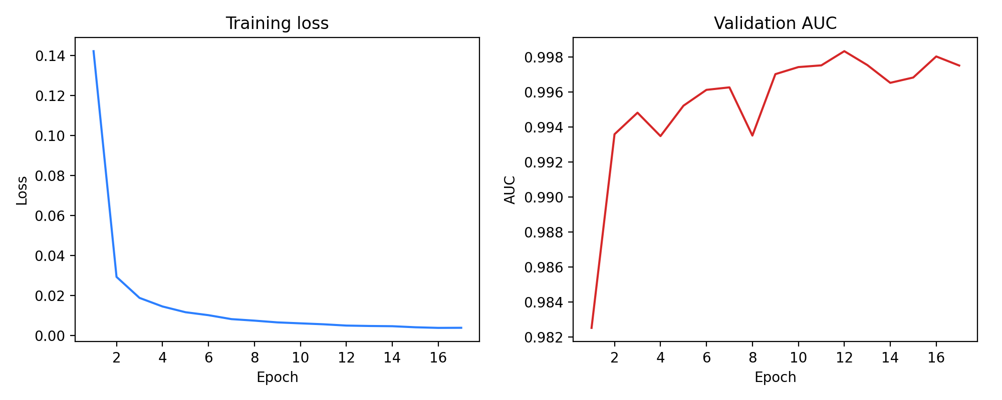
Results: Training Process
CNN: peak AUC ~0.79
LSTM: Training loss reduction much faster

Slide 13
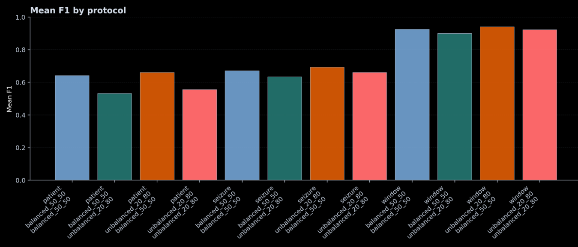
F1 Scores – 3 × 2 × 2 Scenario Comparison
Notes:
The ordering is consistent with the challenge narrative that we expected in the beginning of this report: the time window holdout gives the upper bound of performance, seizure holdout is a personalized unseen-event setting, and patient holdout is the hardest population-level setting to model. The unbalanced test condition typically lowers F1, because it exposes the cost of false positives more realistically.

Slide 14
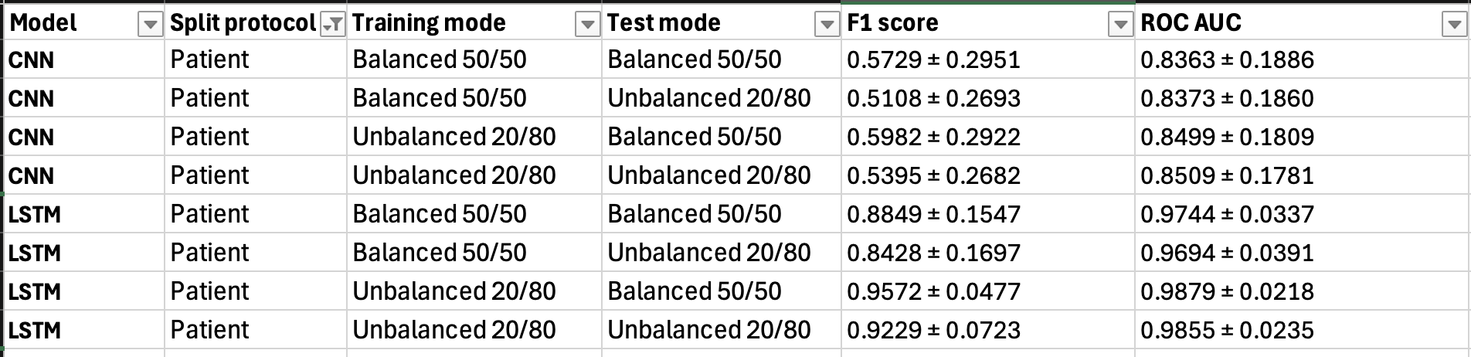
F1 and ROC AUC: Key Insights
Interesting:
Training with balanced classes was slightly worse than training on unbalanced
Contrary to common deep learning practices
Expected:
Fixing leakage led to consistently lower F1 and ROC AUC, but not statistically significant
For the same training mode: ROC AUC is relatively stable across unbalanced vs balanced test, but F1 score drops on unbalanced test (this is expected)

Slide 15
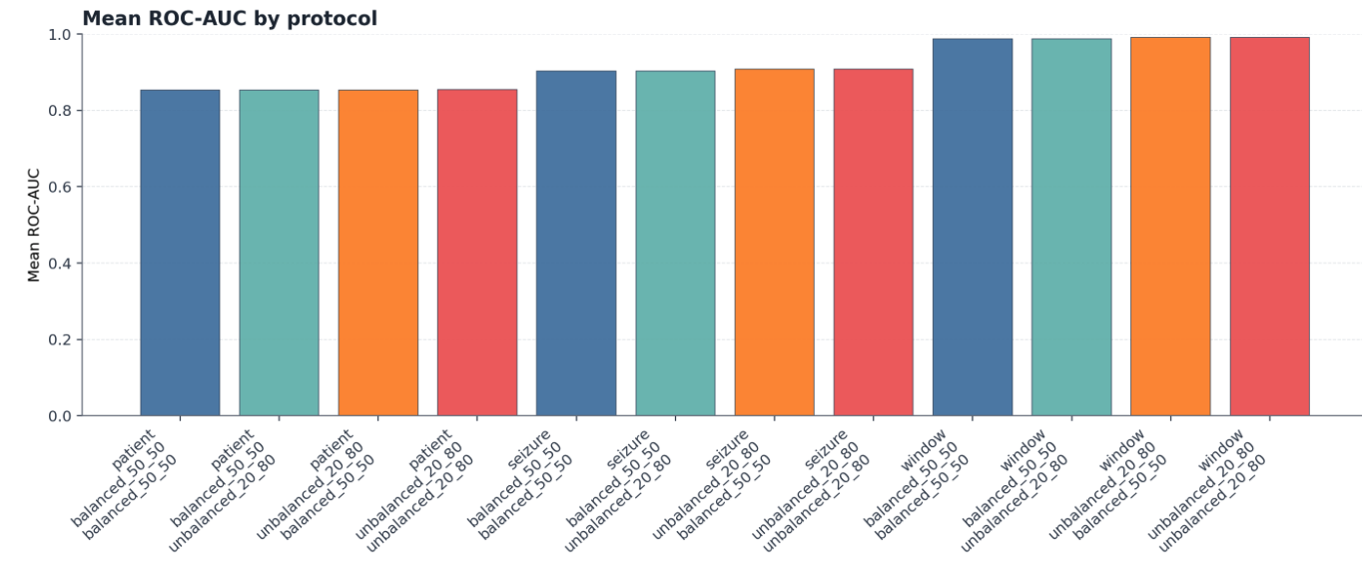
ROC-AUC Scores – 3 × 2 × 2 Scenarios
Notes:
This figure above reports the mean ROC-AUC for the same protocol and sampling matrix as the previous figure. The ranking pattern is similar to F1, but AUC is more stable. This suggests that the model still preserves useful ranking ability under harder protocols, even when the thresholded F1 score drops. In practice, this means class imbalance and threshold selection remain critical for deployment-oriented interpretation. Below, we report the F1 scores in all our sampling and split settings.

Slide 16
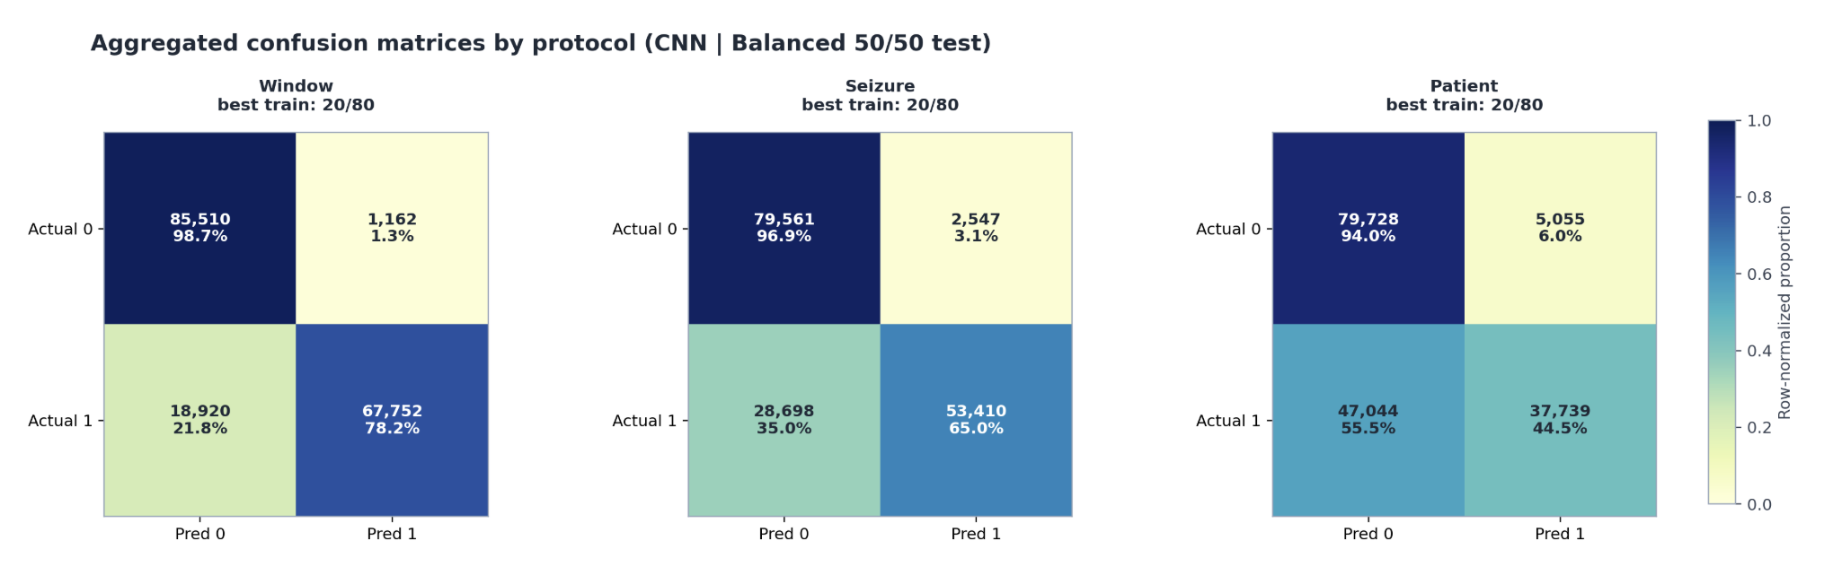
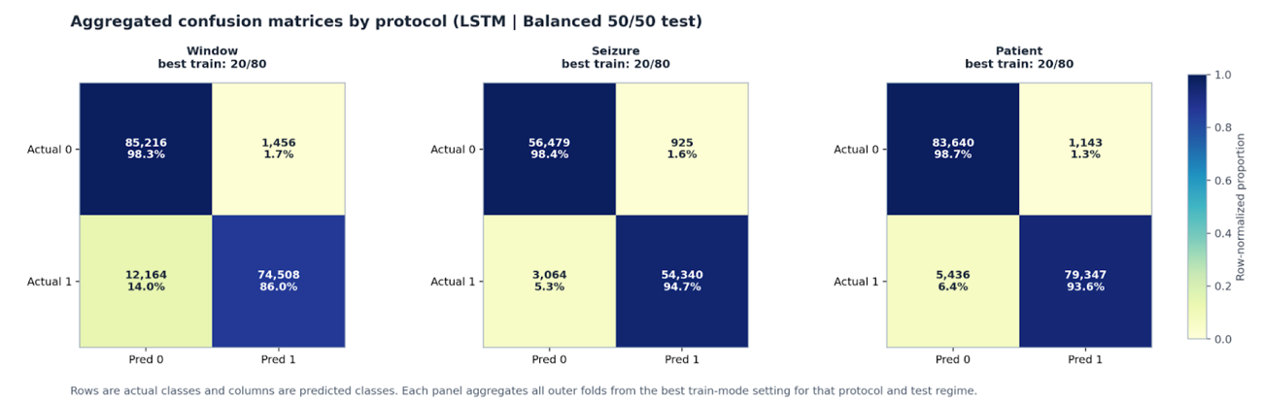
Confusion Matrices: CNN vs LSTM
Notes:
Suggested Summary Paragraph for your Report:
"Comparing the aggregated confusion matrices reveals that the baseline CNN suffers from a severe generalization gap; while it performs adequately on familiar patients (78.2% recall on window-level), its sensitivity collapses to 44.5% when evaluated on unseen patients. In stark contrast, the End-to-End CNN-LSTM maintains a remarkable 93.6% recall and 98.7% specificity even in the strictest Leave-One-Subject-Out protocol. This proves that while static spatial features (CNN) are highly patient-specific, the sequential progression of these features over time (LSTM) provides a universal signature for epilepsy, drastically improving cross-patient robustness.
1. The "Generalization Gap" (The Biggest Story)
The CNN struggles with unseen data: Look at the bottom-right quadrant (True Positives / Recall) of the CNN. As the evaluation gets harder, its performance collapses: 78.2% (Window) ➔ 65.0% (Seizure) ➔ 44.5% (Patient). Because the CNN only looks at 1-second spatial snapshots, it memorizes patient-specific brainwaves. When forced to evaluate an entirely unseen patient, it acts worse than a coin flip at detecting seizures.
The LSTM bridges the gap: Look at the LSTM. Its True Positive rate remains incredibly stable and high across all protocols: 86.0% ➔ 94.7% ➔ 93.6%. By tracking how brainwaves evolve over time (sequences of 8 windows), the LSTM learns the universal temporal signature of a seizure, allowing it to generalize almost perfectly to completely unseen patients.
2. Clinical Sensitivity (Catching the Seizures)
In medical models, False Negatives (bottom-left quadrant) are dangerous because they represent missed seizures.
In the strictest protocol (Patient), the CNN misses 55.5% of all seizure windows.
The LSTM slashes this miss rate down to just 6.4%. It successfully identifies 93.6% of seizure states in brains it has never trained on.
3. Specificity and False Alarms (Top Row)
The CNN actually had decent Specificity (True Negative rate) to begin with, correctly identifying normal brainwaves ~94% to 98% of the time.
However, the LSTM tightens this up even further. Across all three protocols, the LSTM maintains a Specificity of 98.3% to 98.7%. This means the LSTM achieves its massive boost in seizure detection without increasing the false alarm rate.

Slide 17
Conclusion and Next Steps
LSTM performs substantially better, at cost (computational)
Next steps: transformer model
LSTM = detection, transformer = prediction
Nonlinear and longer-window segments
Well-suited for early seizure warning (minutes or hours before seizure)
Overfitting and computational cost
Importance of data splits and generalizability
Window-level: 80% overlap = falsely high performance
Seizure-level: useful in personalized settings to classify seizures of same patient
Patient-level: hardest, but generalizable to new unseen patients

